Slide 1
Time Series

Slide 2
Time Series
Time series is a Record of the chosen data points, such as a Share price, over a specified period of time with data points recorded at regular intervals.
Time series analysis can be useful to see how a given asset, Share price, or economic variable changes over time.
In a time series, time is often the independent variable and the goal (i.e. Share Price) is usually to make a forecast for the future.
It involves working on time (years, days, hours, minutes) based data, to derive hidden insights to make informed decision making.
Time series models are very useful models when you have serially autocorrelated data. Most of business houses work on time series data to analyze sales number for the next year, website traffic, competition position and much more

Slide 3
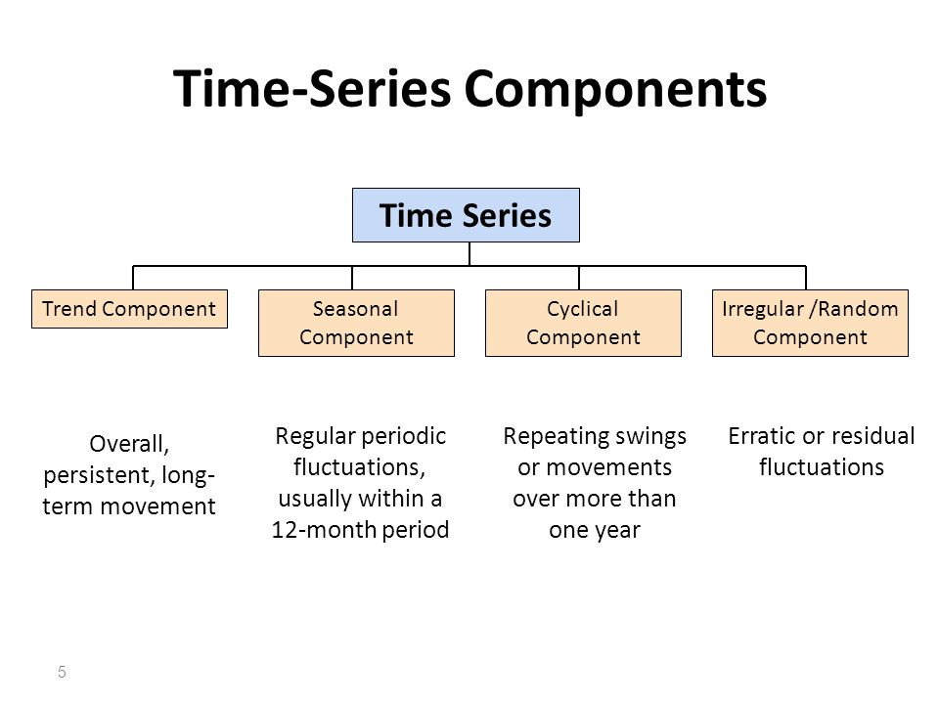

Slide 4
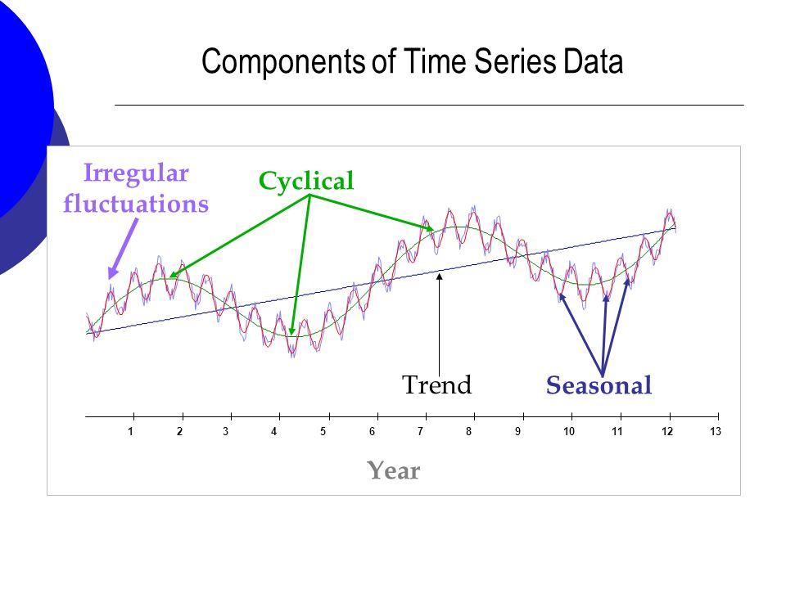

Slide 5
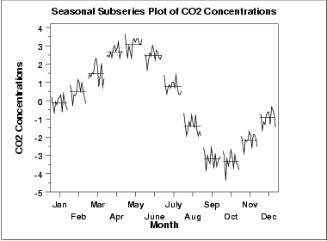
Seasonality
Mean periodic fluctuations.
For example, retail sales tend to peak for the Christmas season and then decline after the holidays. So time series of retail sales will typically show increasing sales from September through December and declining sales in January and February
For monthly data, the period is 12 since there are 12 months in a year.

Slide 6
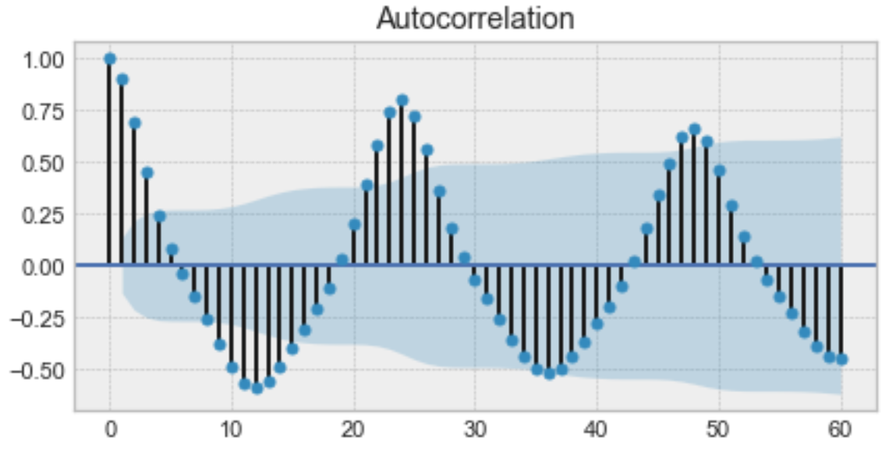
Autocorrelation
Is the similarity between observations as a function of the time, i.e how present values are related to past values
If there is significant seasonality, the autocorrelation plot should show spikes at lags equal to the period.
For example, for monthly data, if there is a seasonality effect, we would expect to see significant peaks at lag 12, 24, 36, and so on

Slide 7
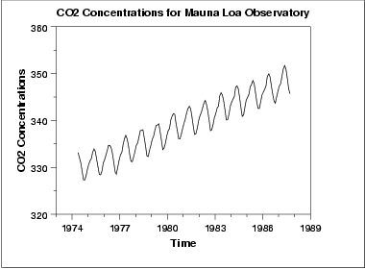
Trend: In order to take a look at the trend of time series data, we first need to remove the seasonality.
Trend shows the general tendency of the data to increase or decrease during a long period of time
Graph having Positive Trend

Slide 8
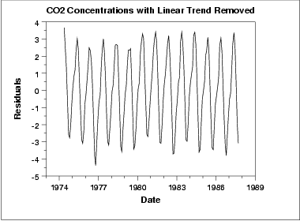
Removing the linear trend

Slide 9
Residuals / error
Each time series can be decomposed in two parts: - A forecast, made up of one or several forecasted values - Residuals are the difference between an observation and its predicted value at each time step
Value of series at time t = Predicted value at time t + Residual at time t

Slide 10
Fundamental steps of building a quality time series model:
Step 1: Making Data Stationary
Stationarity : Shows the mean value and variance of the series that remains constant over a time period; if past effects accumulate and the values increase toward infinity, then stationarity is not met.
The first step in time series modeling is to remove the effects of the trend or season that exist within the data to make it stationary.
Due to the discrete nature of time series data, many time series data sets have a seasonal and/or trend element built into the data.
Seasonal - a recurring pattern over a fixed period of time
Trend - upward or downward movement in the data
Accounting for these embedded patterns is what we call making the data stationary.

Slide 11
A stationary process has the property that the mean, variance and autocorrelation structure do not change over time.
Stationary series refer to flat looking series, without trend, constant variance over time, a constant autocorrelation structure over time and no periodic fluctuations (seasonality).
Transformations to Achieve Stationarity:
Transformations such as logarithms can help to stabilise the variance of a time series. Differencing can help stabilise the mean of a time series by removing changes in the level of a time series, and therefore eliminating (or reducing) trend and seasonality.
Differencing to remove a trend or seasonal effects
Differentiate the data, i.e given the series Zt, we create the new series
Yi = Zi − (Zi−1)
The differenced data will contain one less point than the original data. you can difference the data more than once, one difference is usually sufficient.

Slide 12
2. For non-constant variance, taking the LOGARITHM of the series may stabilize the variance - differencing
For Negative Data, you can add a suitable constant to make all the data positive before applying the transformation. This constant can then be subtracted from the model to obtain predicted (i.e., the fitted) values and forecasts for future point
4. Seasonal Differencing
In seasonal differencing, instead of calculating the difference between consecutive values, we calculate the difference between an observation and a previous observation from the same season.
For example, an observation taken on a Monday will be subtracted from an observation taken on the previous Monday

Slide 13
Checking Stationarity
Plotting rolling statistics – Graphical Method
Plotting rolling means and variances is a good way to visually inspect our series.
If the rolling statistics – Rolling Mean and Rolling Std. exhibit a clear trend (upwards or downwards) and show variance (increasing or decreasing amplitude), then you might conclude that the series is very likely not to be stationary

Slide 14
Augmented Dickey-Fuller Test
This test is used to assess whether or not a time-series is stationary. It is a type of statistical test called a unit root test.
Null hypothesis of the test is that the time series is not stationary, and It has some time dependence
Alternate hypothesis (rejecting the null hypothesis) is that the time series is stationary, and It does not have time-dependence.
p-value > 0.05: We accept the null hypothesis (H0), the data is non-stationary. thus rejecting the Alternate hypothesis
p-value <= 0.05: Reject the null hypothesis (H0), the data is stationary and accept the Alternate Hypothesis

Slide 15
ARIMA: Autoregressive Integrated Moving Average
This method is also known as the Box-Jenkins method. ARIMA models should be used on stationary data only. One should therefore remove the trend of the data
An ARIMA model is characterized by 3 terms: p, d, q
AR stands for autoregressive.
Autoregressive parameter is denoted by p.
p = 0, it means that there is no auto-correlation in the series.
p = 1, it means that the series auto-correlation is till one lag.
Integrated is denoted by d.
d=0 means the series is stationary and we do not need to take the difference of it
d=1 means that the series is not stationary and to make it stationary, we need to take the first difference.
d=2 means that the series has been differenced twice.
More than two time difference is not reliable.

Slide 16
MA Stands For Moving The Average which is denoted by q
q=2 moving average with two lag
In order to test whether or not the series and their error term is auto correlated, we usually use W-D test, ACF, and PACF.
ARIMA = (5,0,8) – ARMA, AR , MA
Auto Regressive
In ARIMA means it is a linear regression model that uses its own lags as predictors. Linear regression models, work best when the predictors are not correlated and are independent of each other and for this we make our time series Stationary
Most common approach to achieve stationarity is Differencing referred by “d”
“p” is the order of the “Auto Regressive” (AR) term. It refers to the number of lags of Y to be used as predictors.
“q” is the order of the “Moving Average”(MA) term. It refers to the number of lagged forecast errors that should go into the ARIMA Model.

Slide 17

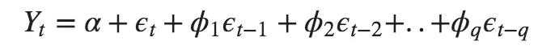
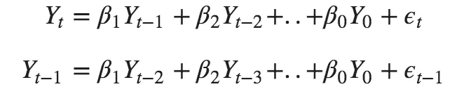
Pure Auto Regressive (AR only) model is one where Yt depends only on its own lags. That is, Yt is a function of the lags of Yt
Pure Moving Average (MA only) model is one where Yt depends only on the lagged forecast errors.
Error terms are the errors of the autoregressive models of the respective lags.
Errors Et and E(t-1) are the errors from the following equations :
beta are the coefficients of lag values, alpha is the intercept term
(Belonging to Linear Regression)

Slide 18
Autocorrelation plots (ACF & PACF) – AR and MA value
Autocorrelation (ACF) Plot represents the autocorrelation of the series with lags of itself. In simple terms, it describes how well the present value of the series is related with its past values.
ACF Graph is used to check the Value to be taken for MA model
Partial Autocorrelation (PACF) Plot - it finds correlation of the residuals
PACF graph is used to check the Value to be taken for AR model
ARIMA (8,1,5)

